Slide 1


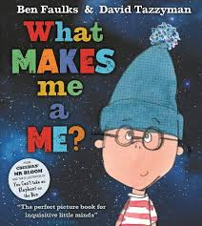


Topic Title: Hudol Mi Term: Autumn Class: Magpies
Autumn 1 :
Health and Wellbeing
All about me - to know that I am special and unique
To recognise similarities and differences between me and my friends
To understand my likes and dislikes
Being part of school and our class
Making friendships
Being part of a family
Being a good friend
Science and Technology
Science: Human Body
Explore facial features
Explore Feelings
Language and Literacy
Oracy:
Talk about myself with new friends
Ask and answer questions
Talk about how I am the same as and different to my friends
Describe the aliens
Reading:
Shared reading of class text
Phonics
Writing:
Write my name
Write phonic sounds
Text
Marvellous Me
Only one you
What Makes me a me?
What makes me Me?
Expressive Arts
Draw a selfie
Create a self portrait using paint
Use natural objects to create a face
Children will design and make their own space alien.
Children will learn about colour mixing in order to
decorate their alien.
Maths
Count up to 20 objects
Recognise numbers to 20

Slide 2

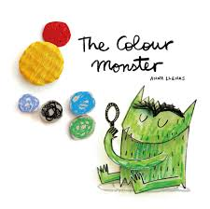
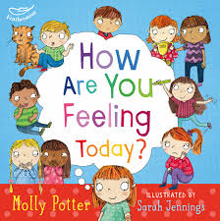
Topic Title: Hudol Mi Term: Autumn Class: Magpies
Autumn 2 :
Health and Wellbeing
To understand my feelings
To talk about my feelings and explain why
To recognise how others feel through their body language and expression
Recognise ways to make myself feel better
Learn how to self regulate
Identify people I can go to for help and support
Science and Technology
Science: Human Body
Identify senses
Describe how the environment has an effect on my senses and how this effects my emotions
Discuss how my body feels when I experience different emotions.
Language and Literacy
Oracy:
Talk about emotions
Ask and answer questions
Talk about how I am feeling and why
Reading:
Shared reading of class text
Phonics
Writing:
Write my name
Write phonic sounds
Text
The Colour Monster
In My Heart
The Worry Monster
How Are you feeling today?
Expressive Arts
Create mood paintings
Draw/make faces with different emotions
Play musical instruments to represent different emotions.
What emotion am I feeling?
Maths
Count up to 20 objects
Recognise numbers to 20

Slide 3

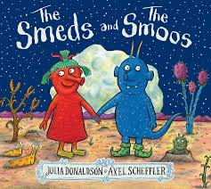
Topic Title: Stargazers Term: Autumn Class: Magpies
Autumn 1 :
Health and Wellbeing
Understand how to be a good friend
Resolving conflicts
Plan a healthy picnic to take to the moon
Jigsaw – Being me in my world
Science and Technology
Science:: Changes of State
Explore what happens to ingredients durig weekly cooking sessions.
Science: Forces
Push and pull – make a rocket move
Language and Literacy
Oracy:
Retell events
Ask and answer questions
Discuss thoughts and feelings
Hot seat of book characters
Discuss themes through text
Reading:
Shared reading of class text
Phonics
Writing:
Write my name
Write phonic sounds
Text
Whatever next?
The smeds and the smoos
What would it be like to visit another planet?
Expressive Arts
Children will design and make their own space alien.
Children will use use junk materials to make their own rocket.
Maths
Position and direction
Shape

Slide 4
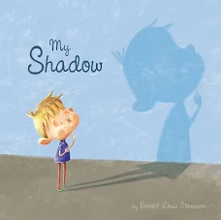
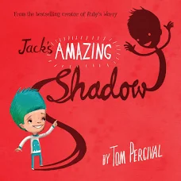
Topic Title: Stargazers Term: Autumn Class: Magpies
Autumn 2 :
Health and Wellbeing
Understand how to be a good friend
Resolving conflicts
Jigsaw – Healthy Me
Science and Technology
To learn about night and day
Understand light sources
Understand how shadows are made
Language and Literacy
Oracy:
Retell events
Ask and answer questions
Discuss thoughts and feelings
Hot seat of book characters
Discuss themes through text
Reading:
Shared reading of class text
Phonics
Writing:
Write my name
Write phonic sounds
Text
My Shadow
Jacks Amazing shadow
What is a shadow?
Expressive Arts
Children will design and make their own
Shadow puppets
Listen to the planets by Holst – how does the music make them feel? What does it make them think of?
Maths
Time of the day
Time – o’clock

Slide 5
Topic Title: Hudol Mi/Stargazers Term: Autumn Class: Magpies
Key Vocabulary
Same
Different
Belong
Family
emotions
Friendship
Sorry
Space
Alien
Planet
shadow
Welsh
Boredau
Syt wyt ti?
Diolch
Dwi’n hoffi
Dwi’n ddim yn hoffi
MFL
Use simple greetings in Welsh/French/
German/ Spanish
RVE
Jigsaw RVE
RSE
Jigsaw
Being me in my world
Healthy me
Community Links
Allotment visits
Christmas fayre
Parent workshops
Cross Cutting Themes
Diversity
Human Rights
Dates for Diaries
3.11.25
School photo day
9.12.25
Christmas concert
9:30 & 2
18.12.25
Blackwood Miners
Pantomime trip

