Slide 1
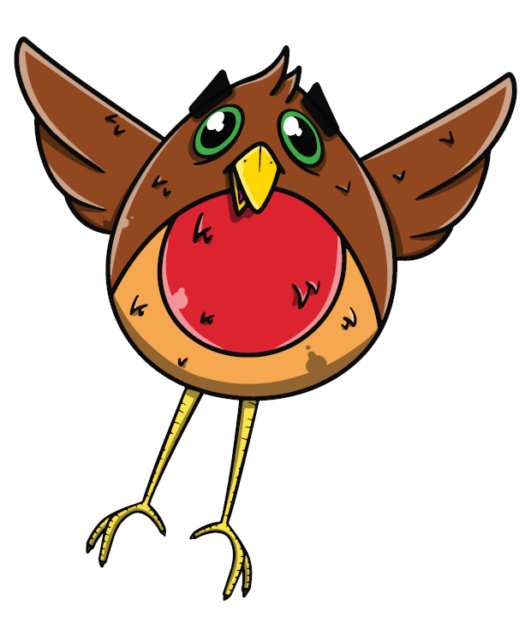

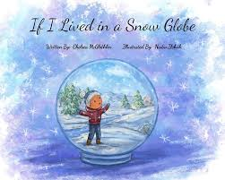

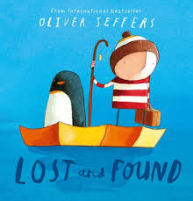
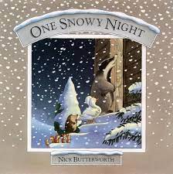

Topic Title: Wonderful Winter Term: Spring Class: N/R/Y1 RW
Health and Wellbeing
Jigsaw- Celebrating difference
Talk about my own experience- snow, ice
Recognise and discuss ways that I can take care of myself- appropriate clothing for weather
Recognise ways that I can take care of others.
Explore friendship and helping others in times of need (will lead into heroes topic)
Science and Technology
Explore change of state- melting ice
Recognise seasonal changes and make comparisons
Science Experiment- How does blubber keep penguins warm?
W/C: 6th, 13th, 20th January :
Language and Literacy
Oracy:
Talk about experiences- recount familiar events
Phonic sounds- segmenting and blending cvc words
Reading:
Read class texts together- recognise tricky words
Read the tricky words
Topic related books- reading area
Writing:
Letter formation- phonic sounds/tricky words
Emergent writing- focused and independent
Comparison- Autumn/Winter
If I lived in a snowglobe
How to create a home for a Penguin/polar Bear
Recount- Emperor’s Egg
Texts:
Expressive Arts
Hot and cold colours- identify difference
Snowflakes- cutting skills
Foil painting
Dance- Swan lake/ snow flakes
Winter- Ice, snow and cold.
Maths
Comparing numbers 4 and 5
Comparing mass Comparing capacity
Is snow heavier than ice? Compare.
Measuring time- melting
Months of the year
Seasonal Months
Humanities
Exploring change in the environment
Habitats
Jigsaw-RVE

Slide 2


Topic Title: New Beginnings/Celebrations Term: Spring Class: N/R/Y1 RW
Health and Wellbeing
Recognise new beginnings- new year resolutions/celebrations
Food tasting- noodles, fortune cookies. Discuss what types of food we eat for celebrations e.g. birthdays, Christmas etc.
Working with partners to create collaborative art work Taking turns and working with others. Self-Confidence and self-awareness Begin to express their own opinions with increasing confidence Are the children confident to try new activities? Managing feelings and behavior The children will work as part of a group Begin to talk about how they and others show feelings
W/C: 27th January and 3rd February :
Expressive Arts
Junk modelling chinese dragon-collaborative
Red Envelopes- giving to others
Chinese dragon dance
Language and Literacy
Oracy:
Twinkl phonics
CVC word building
Talk about my own celebrations
Retell the story
Reading:
Reading Chinese new year books- compare different ones
Writing:
Make marks- chinese lettering
Ongoing developmental writing linked to re telling a story.
Write about one of the animals in the New Year Story.
Captions Labels Illustrations
Twinkl Phonics
Texts:
Maths
Data Handling: graphs of favourite Chinese food flavours. Comparing the sizes of the animals in the story. Tangrams and tessellation.
Counting and sorting Chinese items Use the animals in the story to create number sentences and calculations to solve
Ordinal Numbers
How do people celebrate new beginnings?
https://www.bbc.co.uk/cbeebies/watch/chinese-new-year
Humanities
Begin to understand their location on a world map. Find China on the globe. Are we near? Are we far? How might we travel there? Compare geographical features

Slide 3
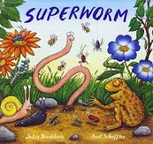
Topic Title: Heroes/People who help us Term: Spring Class: N/R/Y1 RW
W/C: 10th and 17th February :
Health and Wellbeing
Talk about and recognise ways in which people help me and ways in which I help others
Explore the qualities of a good helper
Language and Literacy
Oracy:
Talk about my own experiences
Discussion
Reading:
Topical texts linked to people who help us/heroes
Twinkl Phonics
CVC words
Writing:
How to help……
Evil Pea- wanted poster
Texts:
What is a Hero?
Expressive Arts
Provide the children with a variety of different materials to explore. Ask them to decide which material they would use if they were going to create an outfit for a hero
·Cut large emergency vehicle shapes out of card. Can the children plan and then design a new look for emergency vehicles? They could use paints, collage and different materials.
Humanities
· Take the children to see where different people who help us work. For example, to a post office, fire station or library.
· If any child has a family member who works in a profession who helps others, encourage them to share photos and talk about the job their family member does.
Maths
Addition
Subtraction

Slide 4

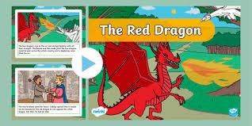
Topic Title: Cymru Term: Spring Class: N/R/Y1 RW
W/C: 3rd and 10th March :
Health and Wellbeing
Belonging- recognising myself as part of a community
Discussing and exploring culture
St Davids Day- being part of community
Performing in the Eisteddfod
Jigsaw- Celebrating Differences/ Relationships
Expressive Arts
Singing Welsh Songs
Welsh Folk Dance
Observational drawing- daffodils, leeks
Junk Modelling- Castles and Dragons
Drawing Dragons- Making Flags
Language and Literacy
Oracy:
Asking and answering questions in Welsh
Dw i’n hoffi/d dwi ddim yn hoffi
Singing song for Eisteddod
Reading:
Traditional Welsh stories/legends
Flfic a Fflac stories
Writing:
Making Welsh Postcards
How to look after a Dragon-
Imaginative writing- I wish I had a Dragon
Texts:
What does it mean to be Welsh?
Science and Technology
Technology: Food and Enterprise
Exploring Welsh Culture and heritage through the making and tasting of traditional Welsh foods
Change of state- cooking
Humanities
Explore the land and landscape of Wales
Traditional tales that have shaped our History-The Story of the Red Dragon
Find Wales and landmarks on the map with support
Maths
Compare mass
Compare Capacity
Weigh and Measure
Measure Time

Slide 5
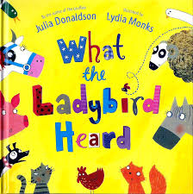
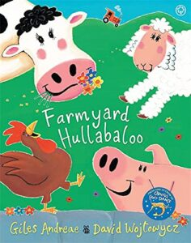


Topic Title: On the farm Term: Spring Class: N/R/Y1 RW
W/C: 17th, 24th, 31st March :
Health and Wellbeing
Go on a spring walk and look for new vocabulary
Recognised seasonal changes in my familiar environment
Work together to build a nest for a chick
Explore spring festivals and celebrations, such as Holi, Mother’s Day and Easter.
Talk about my own experiences
Jigsaw- Relationships
Humanities
Changes in the environment
Spring Festivals
Farming- locations, land, maps
Language and Literacy
Oracy:
Take the children outside and listen for sounds of spring.
New Vocabulary- spring, blossom-
Engage with nature- discussion and observation
Recite poetry
Reading:
Spring/farm stories storytime
CVC words
Writing:
Observational drawing- emergent writing
Sentence building
Retell/recount stories and events
For beginning to spell words and writing short sentences.
Texts:
On the farm
Expressive Arts
Explore colour mixing techniques .
Listen to the spring part of Vivaldi’s ‘Four Seasons’. Children can move and talk about the music and relate it to things they see in spring. Can they dance using spring-coloured streamers and ribbons?
Use and experience different textures
Science and Technology
Talk about new life in spring and match animals and their babies
Growing- planting seasonal veg
Making vegetable signs using woodwork
Maths
Combining two groups
Number bonds- 5, 10
3D shape pattern

Slide 6
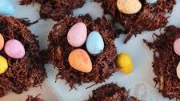


Topic Title: Spring Term: Spring Class: N/R/Y1 RW
W/C: 7th April :
Health and Wellbeing
Working as a team- egg hunt
Talk about my own experiences
Work as team to solve cues
Positional language
Science and Technology
Change of state- making chocolate nests
Language and Literacy
Oracy:
Sing easter songs
Discuss the Easter story
Reading:
Easter themed stories
CVC words
Simple Texts
Writing:
Writing clues- Easter egg hunt- using positional language
Easter
Maths
Repeating pattern
2d shape
3d shape
Expressive Arts
Marble painting eggs
Repeating pattern
Humanities
RVE- Easter story- new life
Planning own Easter egg hunt- making maps

Slide 7
Topic Title: Winter/Spring/ Term: Spring Class: N/R/Y1 RW
Key Vocabulary
Winter
Snow
Ice
Frost
Polar
Frozen
Freezing
Temperature
Penguins
Blubber
Spring
New life
St David
Welsh
Bore da
Prynhawn da
Pwy wyt ti?
Sut wyt ti?
Welsh Numbers 1-5
Welsh Colours
Welsh weather
Ga i….
Dwi’n gwisgo
Dillad- range of vocab
MFL
Use simple greetings in Welsh/French/
German/ Spanish
Sing songs in German and French
RVE
Celebrations-How do people celebrate?
Easter=What is Easter? r
Community Links
Nursery stay and play- Welsh Theme
Reception/Y1- Celebrate being Welsh
Parents and members of the community to be invited to celebrate the reveal of school mural which will honour our local and welsh heroes
Cross Cutting Themes
Human Rights
Careers and work related experiences
Dates for Diaries
Eisteddfod 7.3.25
Trip to the farm
RSE
Relationships
Celebrating Difference

