Slide 1
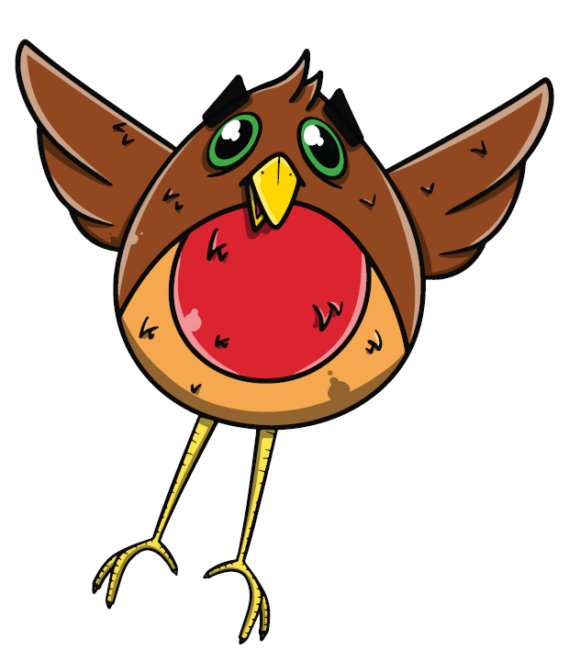

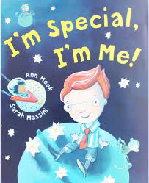




Topic Title: Hudol Mi Term: Autumn Class: N/R/Y1
W/C: 2ND , 9th September 2024 :
Health and Wellbeing
Recognise that I am special and unique
Discuss my physical features
Recognise similarities and difference between me and my friends
Describe my physical qualities
Discuss feeling and emotions
Expressive Arts
Draw a selfie
Use a mirror to look at features and create a self portrait
Use loose parts to make faces
Language and Literacy
Oracy:
Talk about myself with new friends
Ask and answer questions
Discuss similarities and differences
Reading:
Read tricky words
Read phonic sounds
Blend sounds
Writing:
Write my phonic sounds
Write my name
Write tricky words
Write familiar words like Mum and Dad
Texts:
What makes me Me?
Science and Technology
Science: Human Body
Explore facial features
Explore Feelings
Maths
Recognising numbers 1-10
Write numbers 1-10
Recognise my age
Compare height/features
Count objects
Sort items
Facial- symmetry

Slide 2





Topic Title: Hudol Mi Term: Autumn Class: N/R/Y1
W/C: 16th , 23rd September 2024 :
Health and Wellbeing
Being part of school and our class
Making friendships
Being part of a family
Being a good friend
Maths
2d shape
Recognising numbers 1-10
Write numbers 1-10
Recognise my age
Compare height/features
Count objects
One more/one less
Sort items
Facial- symmetry
Language and Literacy
Oracy:
Talk about myself and my family
Ask and answer questions
Discuss similarities and differences
Reading:
Read tricky words
Read phonic sounds
Blend sounds
Writing:
Write my phonic sounds
Write my name
Write tricky words
Write familiar words like Mum and Dad
Emergent writing
Texts:
Belonging- where do I belong?
Humanities
Where do I live?
My local area
My home- who do I live with?
Expressive Arts
Draw my family
Draw my school and my friends
Take part in class music activities

Slide 3
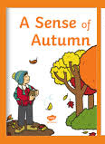
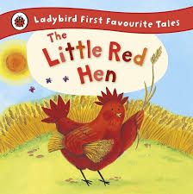
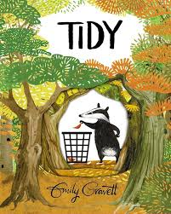

Topic Title: Amazing Autumn Term: Autumn Class: N/R/Y1
W/C: 30th september, 7th, 14th and 21st October 2024 :
Health and Wellbeing
Recognise ways we can help one another
Explore my environment
Work with others to make a collaborative project/product (leaf man class book/ making bread)
Helping others-Harvest
Science and Technology
Recognise signs of the season- Autumn
Create my own leaf man-
Recognise physical changes- making bread, in the environment
Explore changes in the environment- look for signs of Autumn
Investigate pumpkins- explore inside pumpkins
Language and Literacy
Oracy:
Talk about changes
Retell events
Ask and answer questions
Discuss similarities and differences
Reading:
Read tricky words
Read phonic sounds
Blend sounds
Writing:
Write my phonic sounds
Write my name
Write tricky words
Write familiar words like Mum and Dad
Emergent writing
Harvest/ What happens when the leaves fall?
Maths
Sort,order and compare autumn leaves
Weigh and measure ingredients to make bread
Expressive Arts
Learn and perform a harvest song
Music and movement- autumn
Create my own lead character
Colour mixing- display
Explore Kandinsky’s circles- use as inspiration for creating pumpkin themed circle art
Humanities
Look for signs of Autumn
Explore our school environment- forest school area

Slide 4
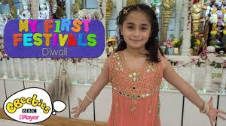


Topic Title: Amazing Autumn Term: Autumn Class: N/R/Y1
W/C: 4th November :
Health and Wellbeing
Consider the feelings of others
To share in the celebrations of different cultures
Talk about how to keep myself safe- bonfire night safety
Science and Technology
Follow a recipe to make salt dough and make a Diva Lamp
Use recycled items to make a poppy
Explore night and day/light and dark
Language and Literacy
Oracy:
Retell events
Ask and answer questions
Discuss thoughts and feelings
Discuss events that we are remembering/celebrating
Reading:
Read tricky words
Read phonic sounds
Blend sounds
Writing:
Write my phonic sounds
Write my name
Write tricky words
Write familiar words like Mum and Dad
Emergent writing-initial sounds
Let’s celebrate Diwali /
We shall remember
Maths
Discuss Day and Night- repeating pattern
Explore repeating pattern in colour, shape, number?
Weigh and measure ingredients to make salt dough
Use shape, pattern and colour to create my own firework picture
Expressive Arts
Create my own Diva Lamp
Use shape, pattern and colour to create my own firework picture using a range of resources
Use recycled items to make my own poppy
Humanities
Explore and discover events- Bonfire Night
Diwali
Remembrance Sunday
Explore night and day

Slide 5



Topic Title: Amazing Autumn Term: Autumn Class: N/R/Y1
W/C: 11th and 18th November :
Health and Wellbeing
Recognise my own routines
Talk about my daily routine
Explore feelings of worry/being scared
Talk about why a good nights sleep is important
Importance of sleeping at nighttime
Science and Technology
Explore Nocturnal animals
Explore night and day/light and dark
Light sources
Language and Literacy
Oracy:
Retell events
Ask and answer questions
Discuss thoughts and feelings
Discuss events that we are remembering/celebrating
Reading:
Read tricky words
Read phonic sounds
Blend sounds
Writing:
Write my phonic sounds
Write my name
Write tricky words
Write familiar words like Mum and Dad
Emergent writing-initial sounds
When the Sun goes down ?
Maths
Discuss Day and Night- repeating pattern
Explore numbers one, two, three - link to owl babes
Time- daily routine, sequence daily events/activities
Compare size- small, medium, large
Expressive Arts
Make our own shadow puppets
Starry Night inspired art
Clay nocturnal animals
Humanities
Explore night and day
Habitats - making nests

Slide 6
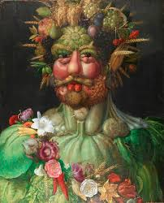
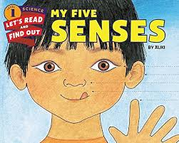
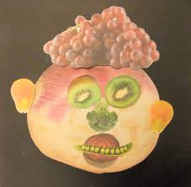
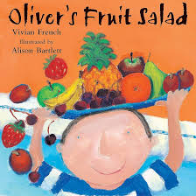


Topic Title: Hudol Mi Term: Autumn Class: N/R/Y1
Health and Wellbeing
Talk about my body
Recognise similarities and differences
Recognise what happens to my body when I eat healthy food-
Express my likes and dislikes
Keep myself safe- bonfire safety
W/C: 25th November and 2nd December
Science and Technology
Science: Human Body
My senses
Recognise changes in my body
Language and Literacy
Oracy:
Talk about myself and my body
Ask and answer questions
Discuss similarities and differences
Reading:
Read tricky words
Read phonic sounds
Blend sounds
Writing:
Write my phonic sounds
Write my name
Write tricky words
Write familiar words like Mum and Dad
Emergent writing
Science and Technology
Technology: Food and Enterprise
Design and create a fruit salad
How can I look after my body?
Maths
Use fruit and vegetables to create repeating patterns
Compare size and weight of fruit and vegetables
Sort fruit and vegetables
Humanities
Recognise that different fruits and vegetables come from different places in the world
Expressive Arts
Print with fruits and vegetables- me myself or my family
Design my fruit salad
Draw fruits from observation

Slide 7
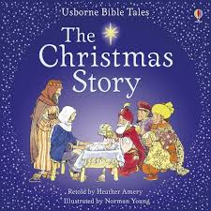
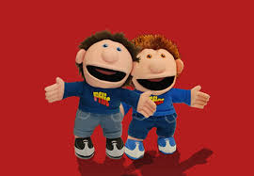
Topic Title: Hudol Mi Term: Autumn Class: N/R/Y1
Health and Wellbeing
Recognise that I have my own birthday
Discuss different ways that people celebrate birthdays
W/C: 9th and 16th December :
Language and Literacy
Oracy:
Talk about myself and my body
Ask and answer questions
Discuss similarities and differences
Reading:
Read tricky words
Read phonic sounds
Blend sounds
Writing:
Write my phonic sounds
Write my name
Write tricky words
Write familiar words like Mum and Dad
Emergent writing
Science and Technology
Technology: Food and Enterprise
Changes of state- melting chocolate to make cakes
Penblwydd Hapus i ti (Birthdays)/ The Birth of Jesus
Maths
Weigh, measure
Number recognition
Ordering number
Humanities
The birth of Jesus- christianity
Expressive Arts
Design and make decorations
Design and make cards

Slide 8
Topic Title: Hudol Mi Term: Autumn Class: N/R
Key Vocabulary
Feelings
Emotions
Human Body
Senses
Autumn
Seasons
Welsh
Bore da
Prynhawn da
Pwy wyt ti?
Sut wyt ti?
Welsh Numbers 1-5
Welsh Colours
MFL
Use simple greetings in Welsh/French/
German/ Spanish
RVE
Jigsaw RVE
RSE
Jigsaw
Being me in my world
Healthy Me
Christmas concert
Theatre trip with parents
Dates for Diaries
9th December- Trip
11th December- concerts
Community Links
Cross Cutting Themes
Diversity
Human Rights

