Slide 1
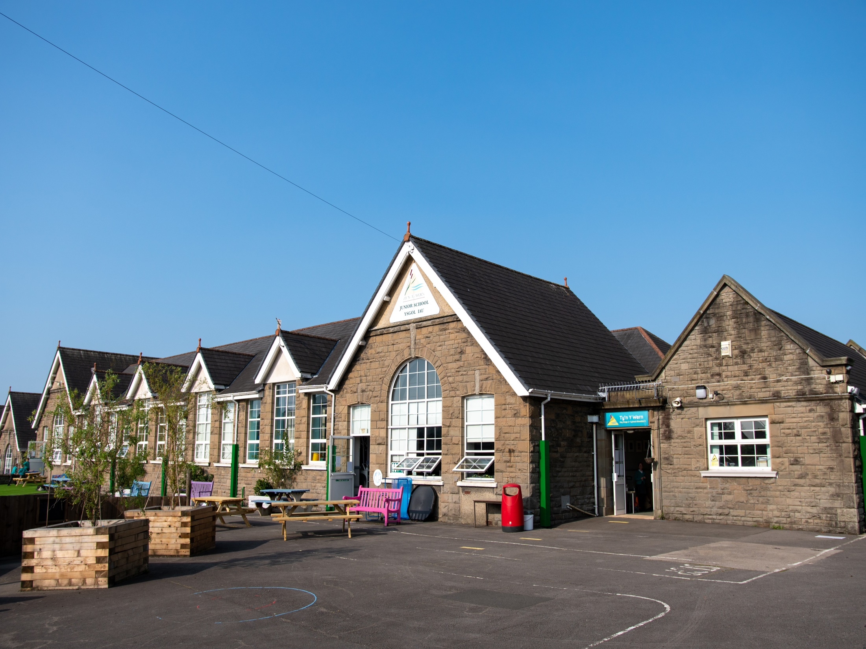

Ty’n y Wern Primary
Curriculum Summary
In September, all Primary Schools and some Secondary Schools will be introducing the new Curriculum for Wales. It aims to help each school develop its own curriculum, enabling their learners to develop towards the four purposes of the curriculum – the starting point and aspiration for every child and young person in Wales. It will suit their needs and help them reach their full potential. This document outlines our curriculum development journey, so far…

Slide 2
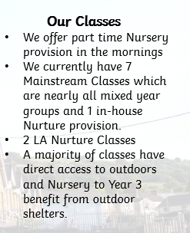
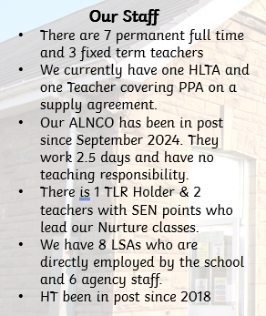
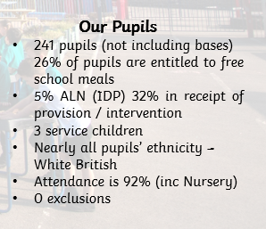
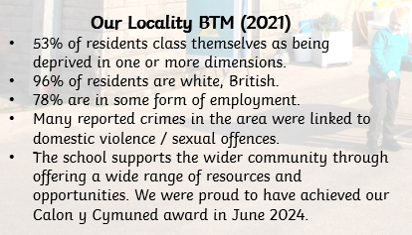
All About Us
We have designed our curriculum with the needs of our pupils and community in mind.

Slide 3
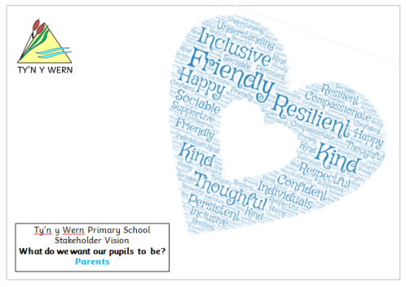
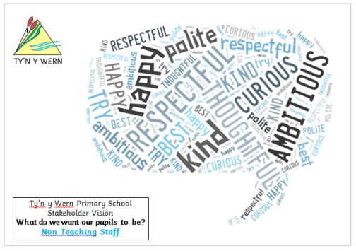
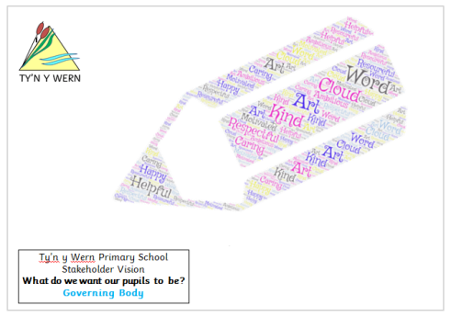
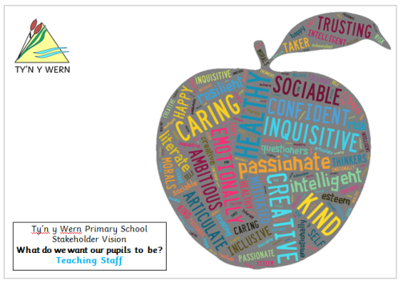
Vision
We consulted with all stakeholders when revisiting our vision for the school. All parties agreed that it was important for our pupils to be…
HAPPY
SAFE
CURIOUS
VALUED
INCLUSIVE
CONFIDENT
CARING
RESPECTFUL
RESILIENT
NURTURED
In order to be the best version of themselves.

Slide 4
Vision
Together We Reach New Heights
Our mission statement ‘Together We Reach New Heights reflects our aim to ensure that every member of Ty’n y Wern reaches their full potential whether this be through academic or social achievements.
Our bespoke curriculum gives every learner the opportunity to try something new, giving them the chance to find interests that they both enjoy and can excel at.
The ‘together’ reflects the strong team ethos and supportive nature of our school.
#TeamTYW

Slide 5
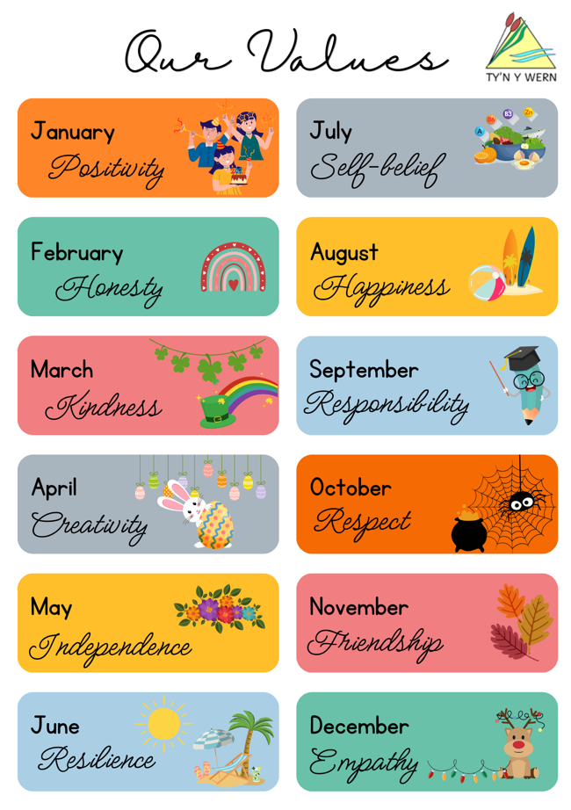
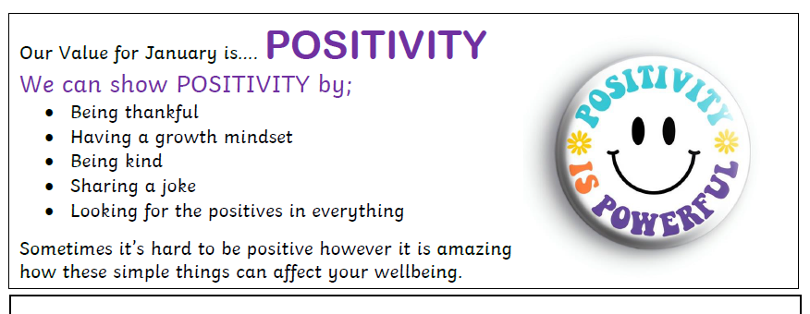

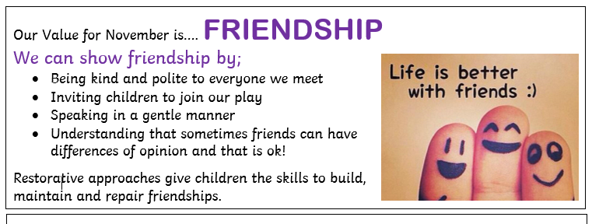
Values
We are a Values Based Education School. Each month a new value is introduced, and pupils are encouraged to demonstrate this value through their work and behaviour. Practitioners will refer to the values and will emphasise them through stories and events in lessons and through collective worship.
We share our Value of the Month with all stakeholders in our monthly newsletter.

Slide 6
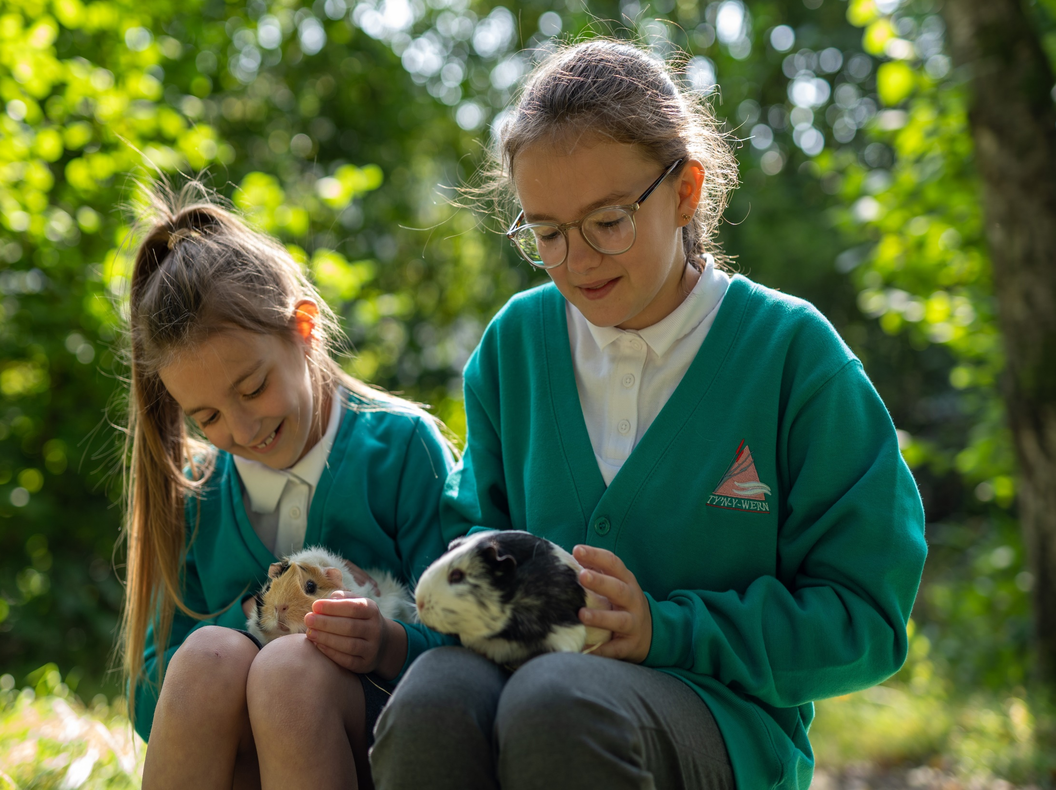
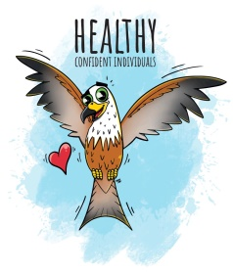
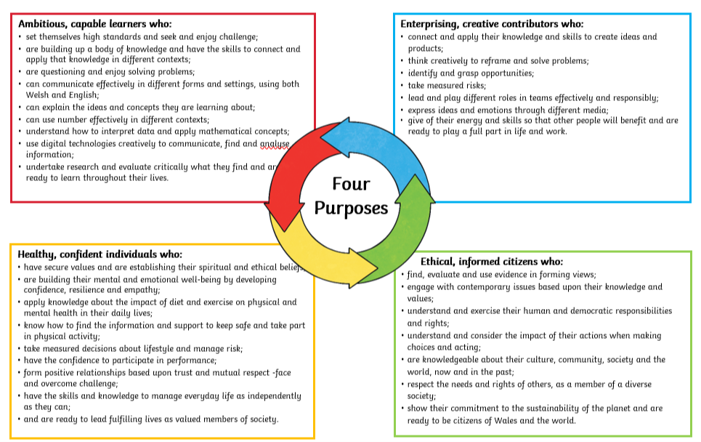
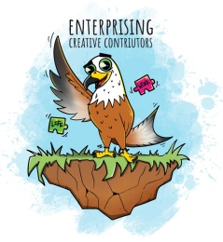
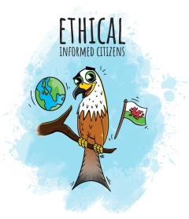
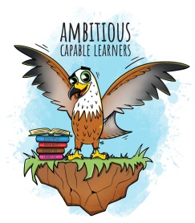
The Four Purposes
At the heart of our curriculum are the Four Purposes, a shared vision and aspiration for all. Our Four Purpose mascot is Bryn y Barcud Coch (Red Kite), a symbol of strength, Cynefin and the ability to soar to new heights,
“A school’s curriculum is everything a learner experiences in pursuit of the four purposes. It is not simply what we teach, but how we teach and crucially, why we teach it.” WAG 2020
Notes:
for

Slide 7
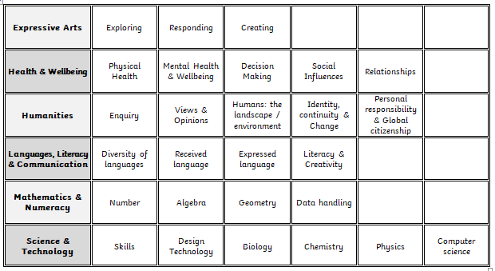
AOLES
The curriculum is made up of six Areas Of Learning and Experiences. We use the Health and Wellbeing, Humanities and Science and Technology AOLEs as content drivers for our themes and topics, with the three other AOLEs of Languages, Literacy and Communication, Mathematics and Numeracy and Expressive Arts being woven throughout each term. In doing so we ensure a broad and balanced curriculum for all.
Each AoLE consists of Statements of What Matters. Our curriculum planning pays great consideration to these and has been designed to ensure that the process of exploring and revisiting these statements enables learners to develop ever deeper knowledge during their learning journey.
Notes:
for

Slide 8
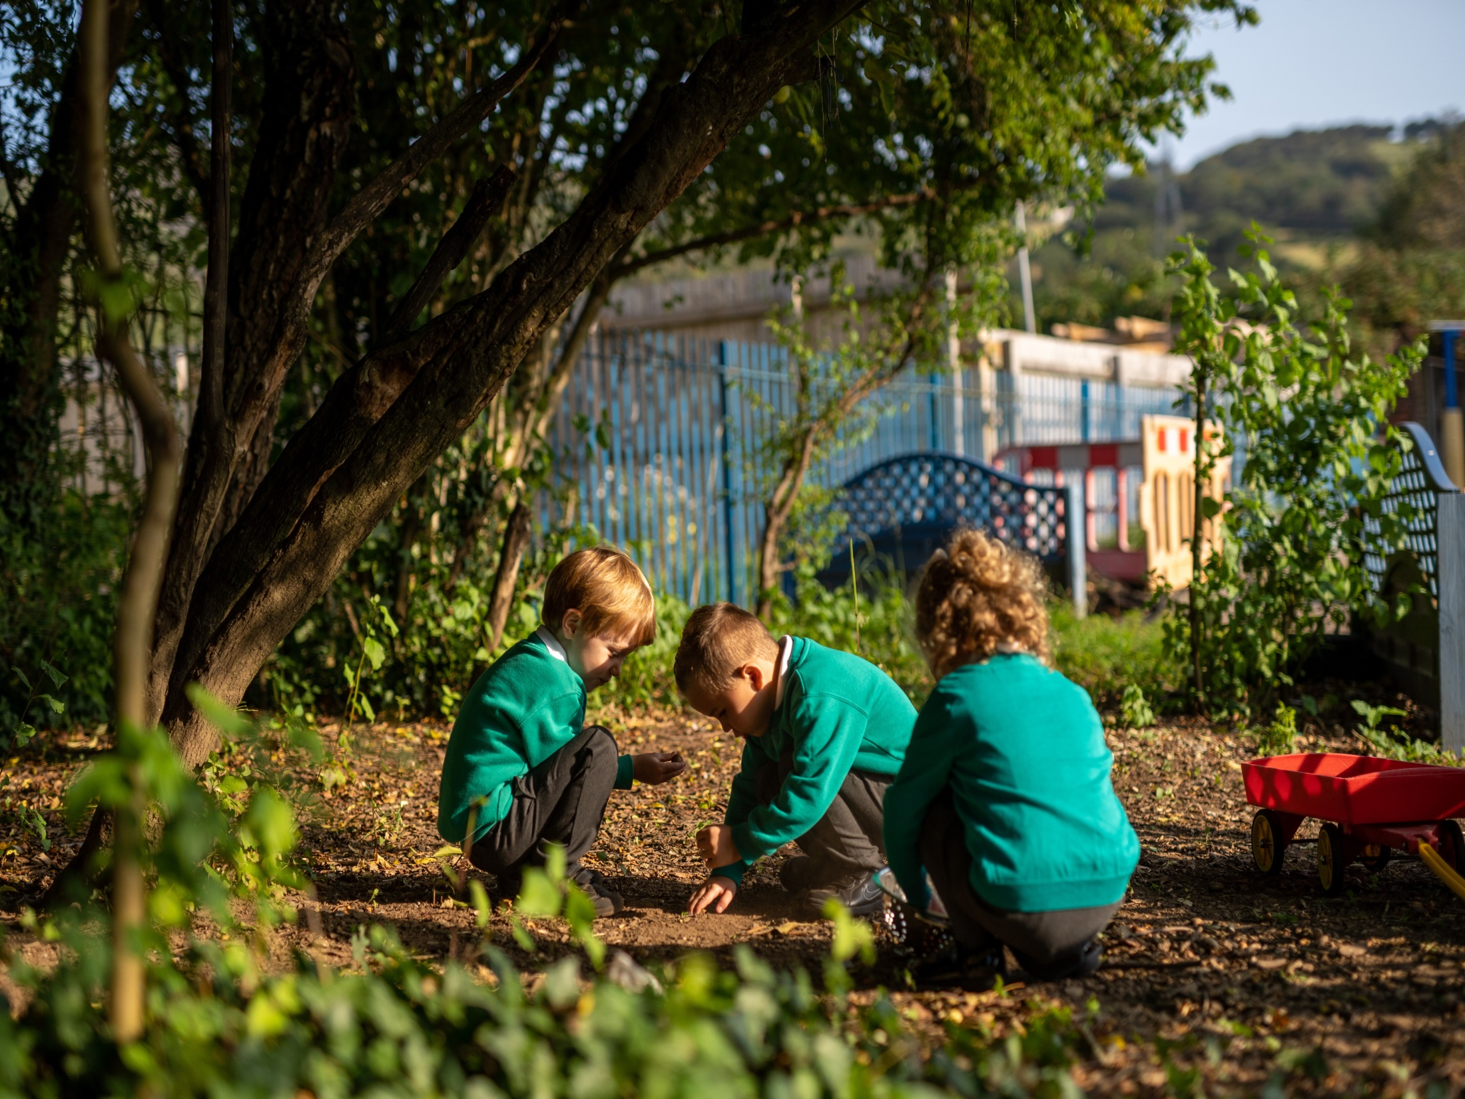
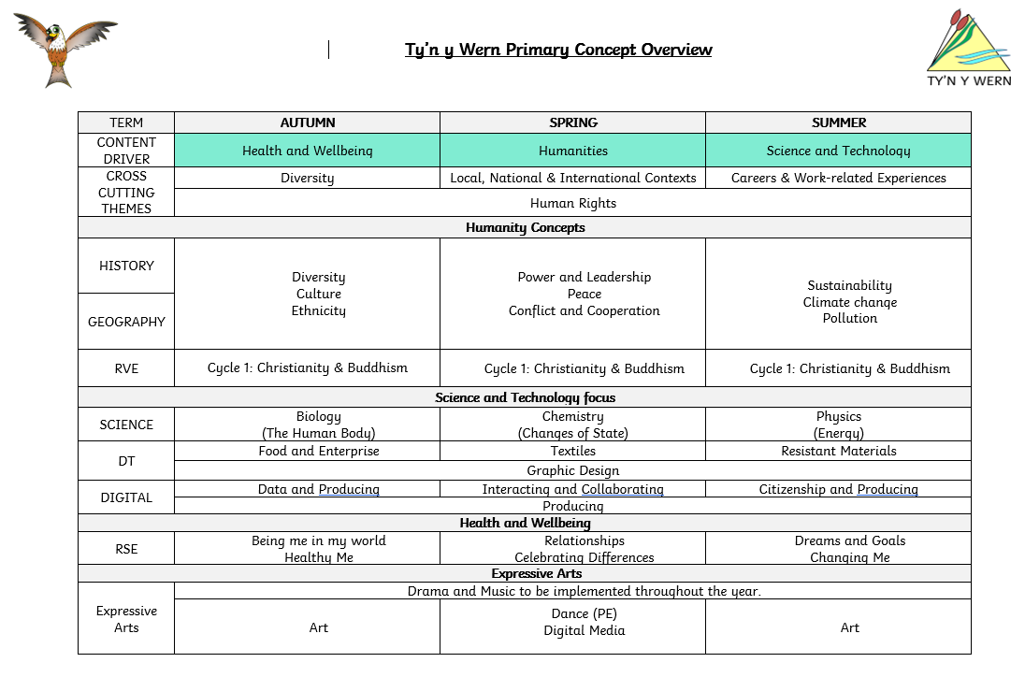
Our Curriculum
In addition to the AOLEs there are other interdisciplinary links which are mapped across all curriculum areas. The pupils are at the heart of our curriculum with a strong focus on pupil voice ensuring that our learners have the opportunity to shape our curriculum, drawing on their interests and including contemporary and topical issues.

Slide 9
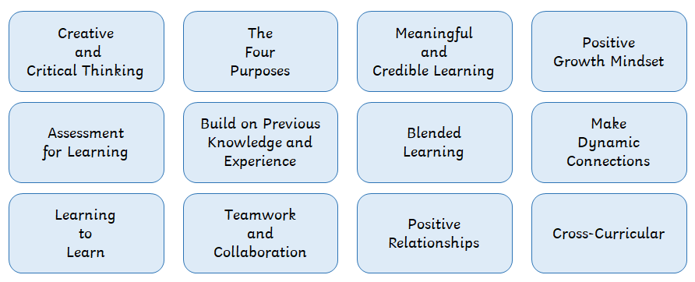
Pedagogical Principles
These principles will help our learners develop:
A strong disposition to learning
Strong metacognitive skills
Critical, creative, problem-solving skills
Highly effective communication skills
We endeavour to always provide high standards of teaching and learning. All staff make good use of Professional Learning opportunities to reflect and develop good practise. Our staff use the 12 Pedagogical Principles to provide the most effective methods of learning for our pupils, using current research and evidence to support their practise.

Slide 10
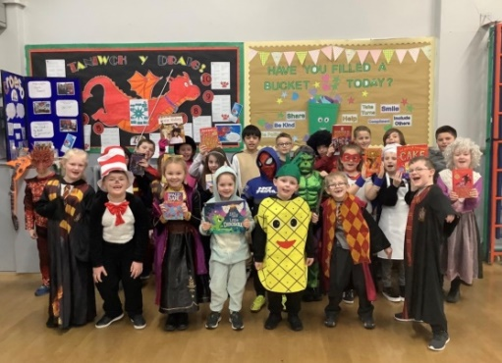
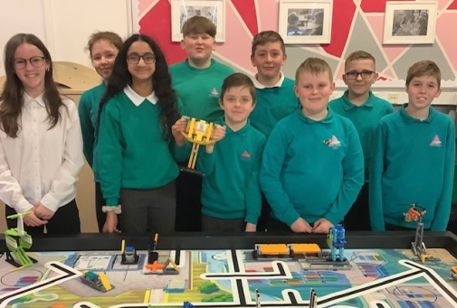
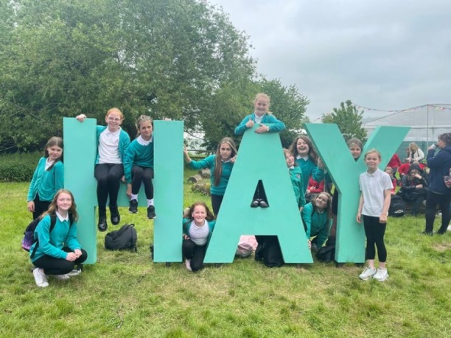
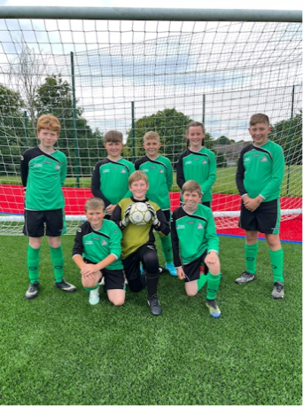
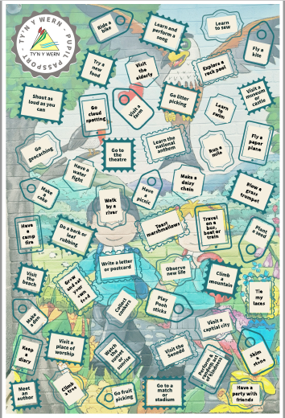
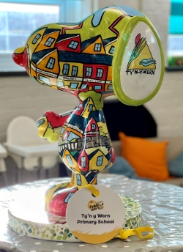
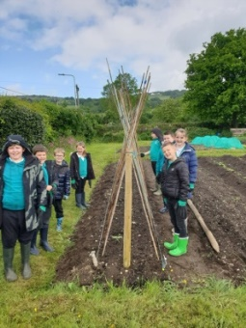
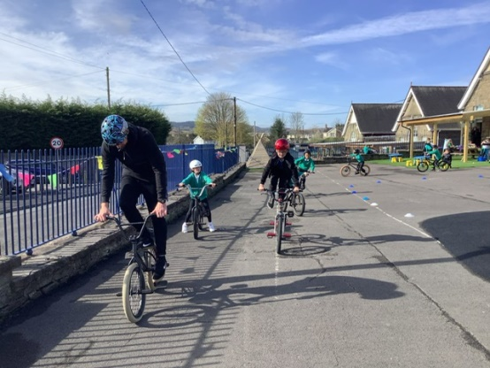
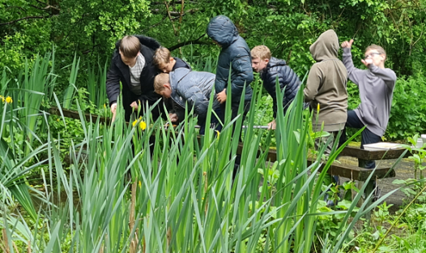
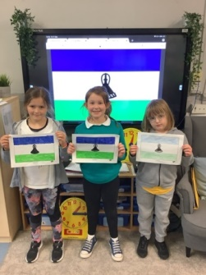
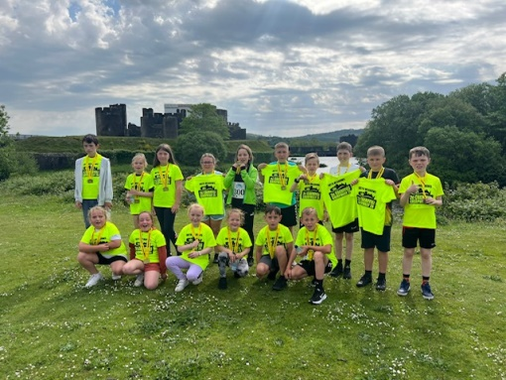
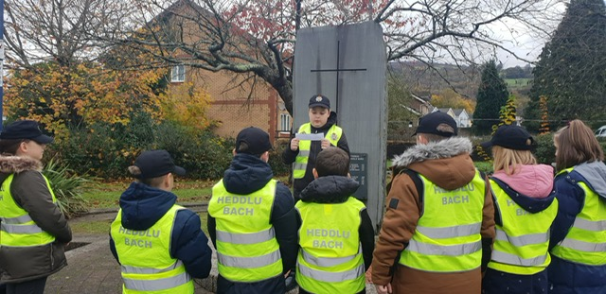
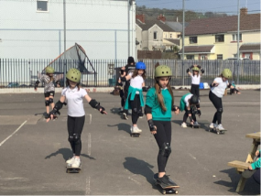
AOLExperiences
At Ty’n y Wern we are very proud of the wealth of experiences that we provide for our learners. In addition to themed based trips, visitors and events we have also our own ‘Pupil Passport’ an entitlement of 50 activities which we would like all learners to experience by the time they leave TYW.

Slide 11
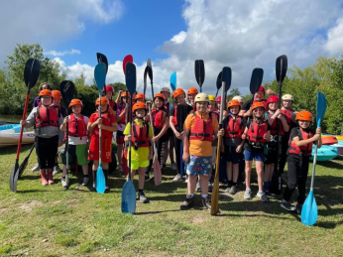
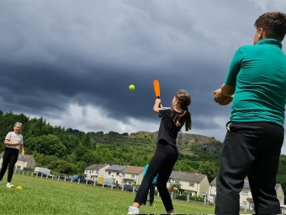
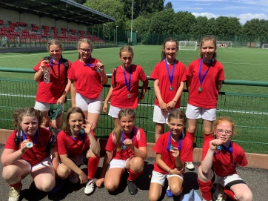

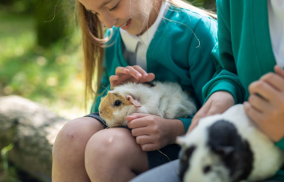
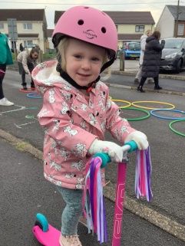
Wellbeing & ALN
All aspects of the Health and Wellbeing AOLE are key concepts in our curriculum and are integral to everything we do at Ty’n y Wern. As well as being the content driver for our Autumn term topic, pupils’ physical health and development, mental health and emotional and social wellbeing are
are a priority throughout our curriculum. Ty’n y Wern hosts two specialist Nurture classes for the local authority and a nurturing, inclusive and caring ethos
permeates the school.
Here are just some of the wellbeing strategies and interventions that our staff are trained in;
Thrive
Nurture Principals
Elsa
Draw and Talk
Lego Therapy
ASD Friendly classrooms
Group Theraplay
Theraputic story writing
Additional Learning Needs
The school is committed to Additional Learning Needs (ALN)
transformation. Learners on the existing ALN register, and
within mandated cohorts, have been transferred to the new
system using Edukey to manage and evaluate provision.
Person Centred Planning (PCP) meetings regularly take
place for identified learners.
Our learners benefit from an extensive range of sporting / physical opportunities which have been mapped across our curriculum.

Slide 12






Llais – Pupil Voice
The involvement of pupils in the ongoing design of our curriculum is key. We have many pupil voice groups who contribute to school improvement activities through responding to surveys and reports.
Many of our Llais groups lead initiatives within school and represent the school at local and national events and competitions. We are currently working towards our silver Cymraeg Campus and Gold Active Journeys Awards.

Slide 13
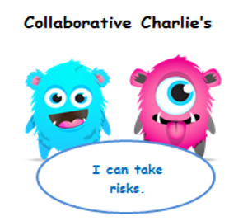
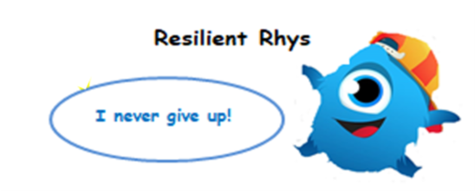
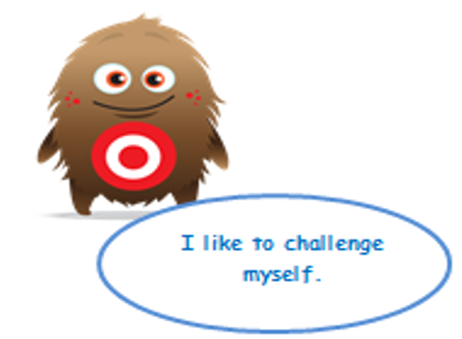
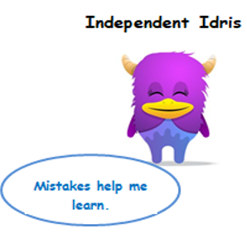
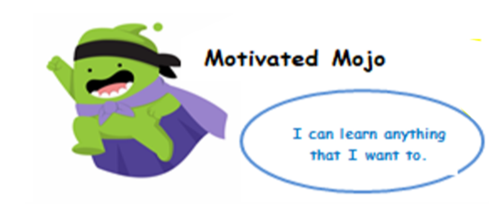
Growth Mindset
Collaboration Charlies
Edward Effort
Resilient Rhys
Independent Idris
Motivated Mojo
Motivated Mojo
At Ty’n y Wern, we have developed 5 Growth Mindset characters that illustrate the attributes we encourage our leaners to develop. When we encourage a Growth Mindset in children they become enthusiastic learners. A Growth Mindset means that their intelligence can be developed which has a positive effect on their motivation and subsequently their achievement.
Dweck’s research shows that we produce confident learners when we praise students for the process they engage in and not for being bright, clever or talented. We aim to create a learning environment where children are willing to try, push themselves, take on challenges and risk making mistakes.

Slide 14
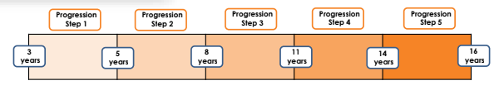

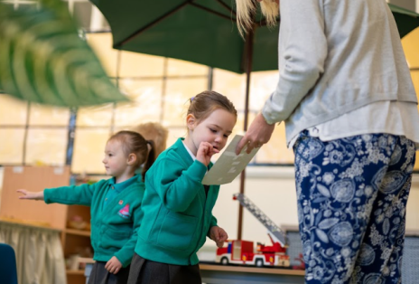
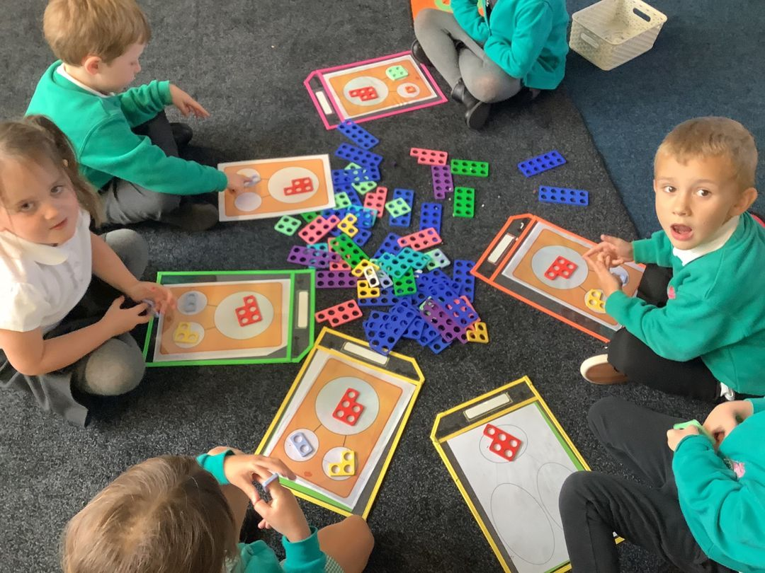
Assessment & Progression
Progression: To support the development of the curriculum and to ensure that all learners make progress the Welsh Government have provided schools with ‘Descriptions of Learning’. The descriptions provide guidance on how learners should progress within each of The what matters statements and are arranged in five progression steps as shown below. At Ty’n y Wern, opportunities to identify progression are highlighted within the teachers short and medium term planning. Feedback and feedforward is delivered ‘in the now’ to ensure that all learners are able to reflect, respond and improve their learning effectively.
Assessment: At Ty’n y Wern we want to ensure that all learners reach their full potential and therefore having a thorough and robust assessment cycle is essential. The sole purpose of any assessments is to ensure that we can tailor the curriculum to the needs of all learners. We have worked closely with the other schools within our cluster including the high school to devise a clear and concise assessment plan which will ensure continuity across all schools.

Slide 15
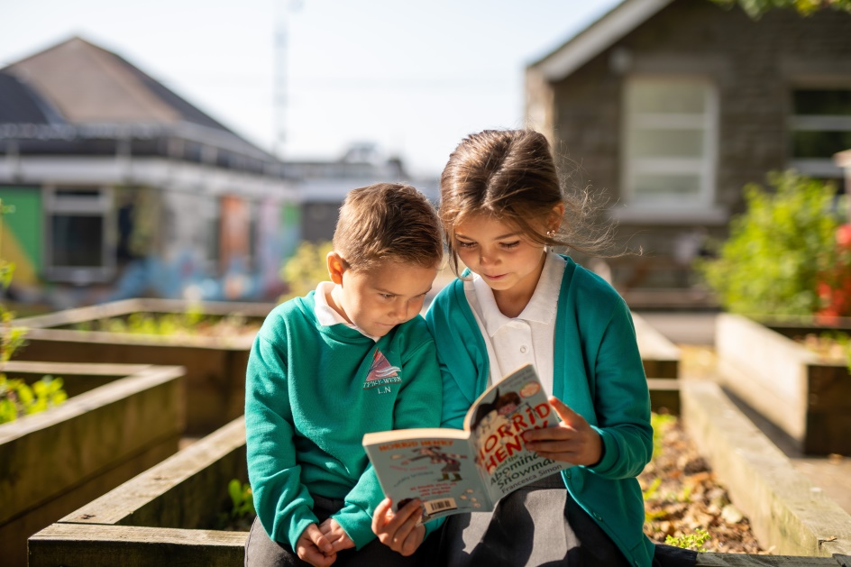

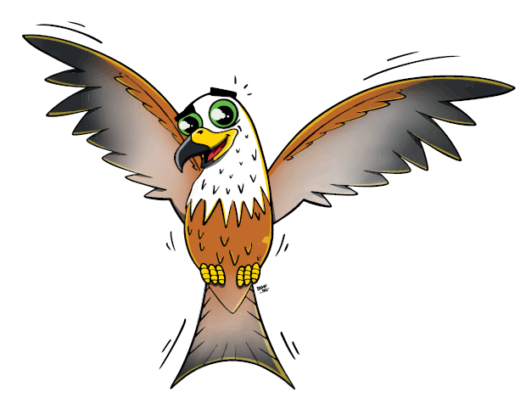
Curriculum Review
Our curriculum design journey has been a reflective process from the beginning, which has seen several changes and amendments throughout. September is only the starting point and we will undoubtedly continue to review practises at regular intervals, in order to ensure that we are securing excellence. We will keep all stakeholders fully informed of any updates.

